Slide 1
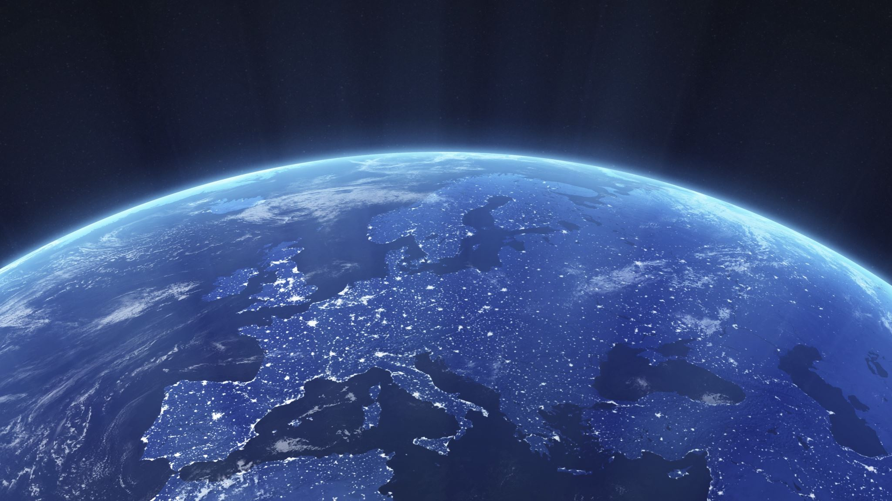

Earth Day
April 22nd
Student Support & Attendance Services
Human Relations, Diversity & Equity

Slide 2
Would you rather...
Have a pet dragon
Have a pet gargoyle

Slide 3
Objectives
Learn the history of Earth Day
Discuss the importance of the Day
Learn what you can do

Slide 4
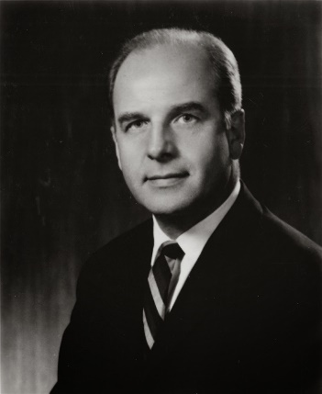
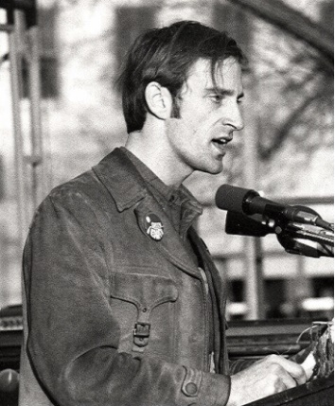
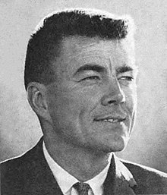
History of Earth Day
Senator Gaylord Nelson, a junior senator from Wisconsin, had long been concerned about the deteriorating environment.
January 1969 – the world witnessed the ravages of a massive oil spill in Santa Barbara, California.
Senator Nelson announced the idea for a teach-in on college campuses and persuaded Pete McCloskey, a Republican Congressman, to serve as his co-chair.
They recruited Denis Hayes, a young activist, to organize the campus teach-ins.
They choose April 22, a weekday falling between Spring Break and Final Exams, to maximize student participation.
Notes:
Pictured from left to right: Gaylord Nelson, Pete McCloskey, Denis Hayes

Slide 5
What Came Next?
The first Earth Day led to the creation of the Environmental Protection Agency
1970 Congress passed the National Environmental Education Act, the Occupational Safety and Health Act, and the Clean Air Act.
1972 Congress passed the Clean Water Act.
1973 Congress passed the Endangered Species Act and soon after the Federal Insecticide, Fungicide, and Rodenticide Act.
1990 - Earth Day went global, mobilizing 200 million people in 141 countries and lifting environmental issues onto the world stage. Earth Day 1990 gave a huge boost to recycling efforts worldwide and helped pave the way for the 1992 United Nations Earth Summit in Rio de Janeiro

Slide 6

What is the most interesting thing you've learned so far about the history of Earth Day?

Slide 7
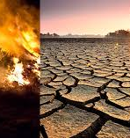
Earth Day Today...
Earth Day is the largest secular observance in the world.
More than a billion people participate as a day of action to change human behavior and create global, national and local policy changes.
The fight for a clean environment continues with increasing urgency, as the ravages of climate change become more and more apparent every day.

Slide 8
What is the most important issue regarding our Earth today?
What can be done about it?

Slide 9
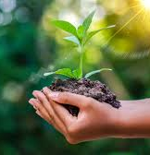
What Can You Do?
Acts of Green: organize a tree planting in your city
Civic Action: Advocate for climate action at your school/district
Community Action: Become a citizen scientist
Individual Action: make your next meal plant based, recycle
For more information about these and other steps to help the planet, visit https://www.earthday.org/take-action-now/

Slide 10
What is one thing you can commit to doing to help our Earth?

Slide 11

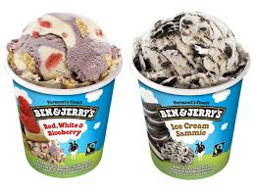
Which is better?

Slide 12

Teacher Feedback Survey
Notes:
Teacher, please scan the QR code to complete a brief survey

Slide 13
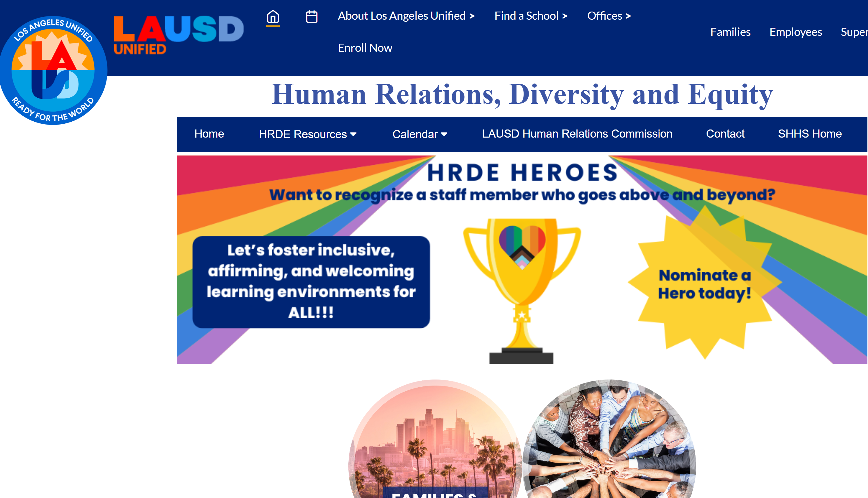
For additional resources, visit us at: https://www.lausd.org/human-relations

